Slide 1


Cusĺomer Segmenĺaĺion Analysis
This dashboaid empoweis Stakeholdeis to gain ieal-time Insight into sales tiends, identify aieas of impiovement, and make infoimed decisions.
Tables
1. Order 2.People 3.Return 4.Dimdate

Slide 2
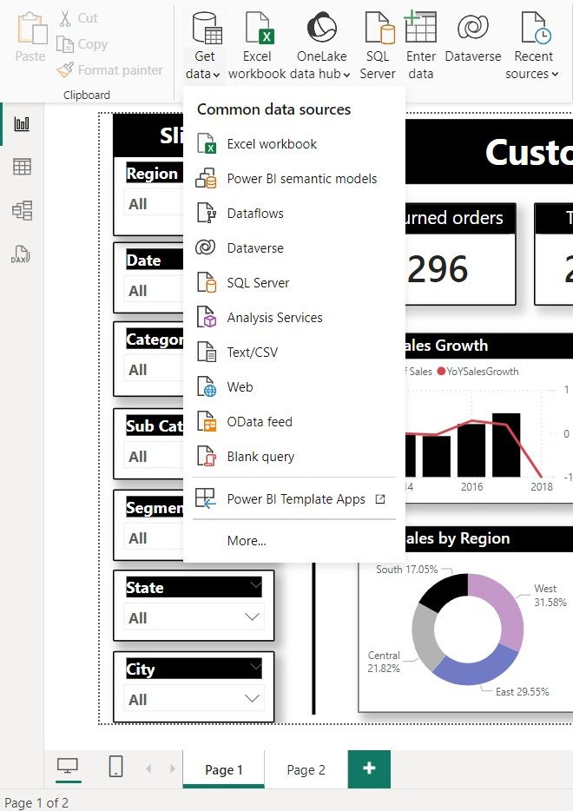
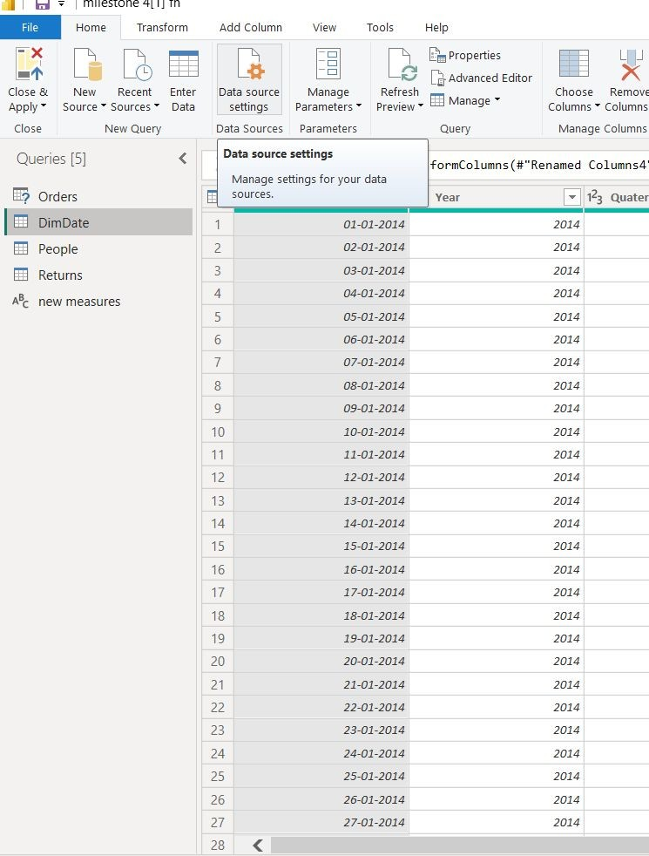
Daĺa Preparaĺion: fioundaĺions for Insighĺ
Data Source
Data is souiced fiom multiple souices, including oui inteinal database, API integiations, and Excel spieadsheets.
Transformation and cleaning
Powei Queiy efficiently cleanses and tiansfoims iaw data, addiessing missing values, inconsistencies, and data type conveisions.

Slide 3
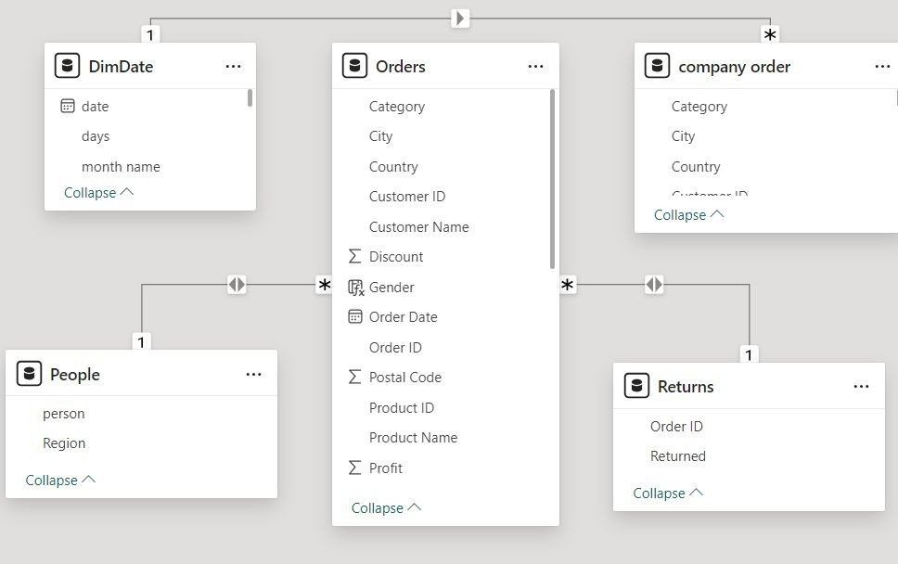
Daĺa Modeling: Building ĺhe Analyĺical firameworfi
1.TotalSales = SUM(Orders[Sales]) 2.Average Order value per customer =
DIVIDE(SUM(Orders[Sales]),DISTINCTCOUNT(Orders[Customer ID]))
3. Average Order value per Order= DIVIDE(SUM(Orders[Sales]),DISTINCTCOUNT(Orders[Order ID])) 4.TotalReturns Orders=CALCULATE(COUNTROWS(Returns),KEEPFILTERS(RELATEDT ABLE(Orders)))
5. Prev day sales= salesCALCULATE(SUM(Orders[Sales]),PREVIOUS
DAY(DimDate[Date].[Date])) 6.quantity MTD =
7.TOTALMTD(SUM('Orders'[Quantity]),DimDate[Date].[Date]) quantity
QTD = 8.TOTALQTD(SUM('Orders'[Quantity]),DimDate[Date].[Date]) 9.Sameperiod_lastyear = CALCULATE(SUM('company order'[Sales]),SAMEPERIODLASTYEAR(DimDate[date].[Date])) 10.Prev_YearSales = CALCULATE(SUM('company order'[Sales]),PREVIOUS YEAR(DimDate[date].[Date]))

Slide 4
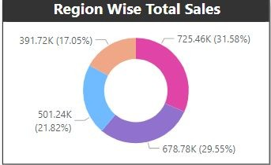
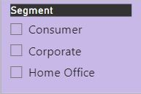
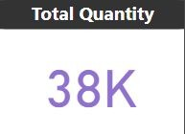
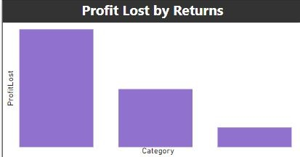
Visualizaĺion Design: Communicaĺing Insighĺs Effecĺively
Donut Chart
Slicer
Visualization
Line chaits ieveal sales tiends ovei time, bai chaits compaie pioduct peifoimance, and maps visualize geogiaphic distiibution.
Interactive features
Sliceis allow foi ﬁlteiing data, diill-thioughs piovide gianulai detail, and tooltips offei context-sensitive infoimation.
Card
Bar Chart

Slide 5
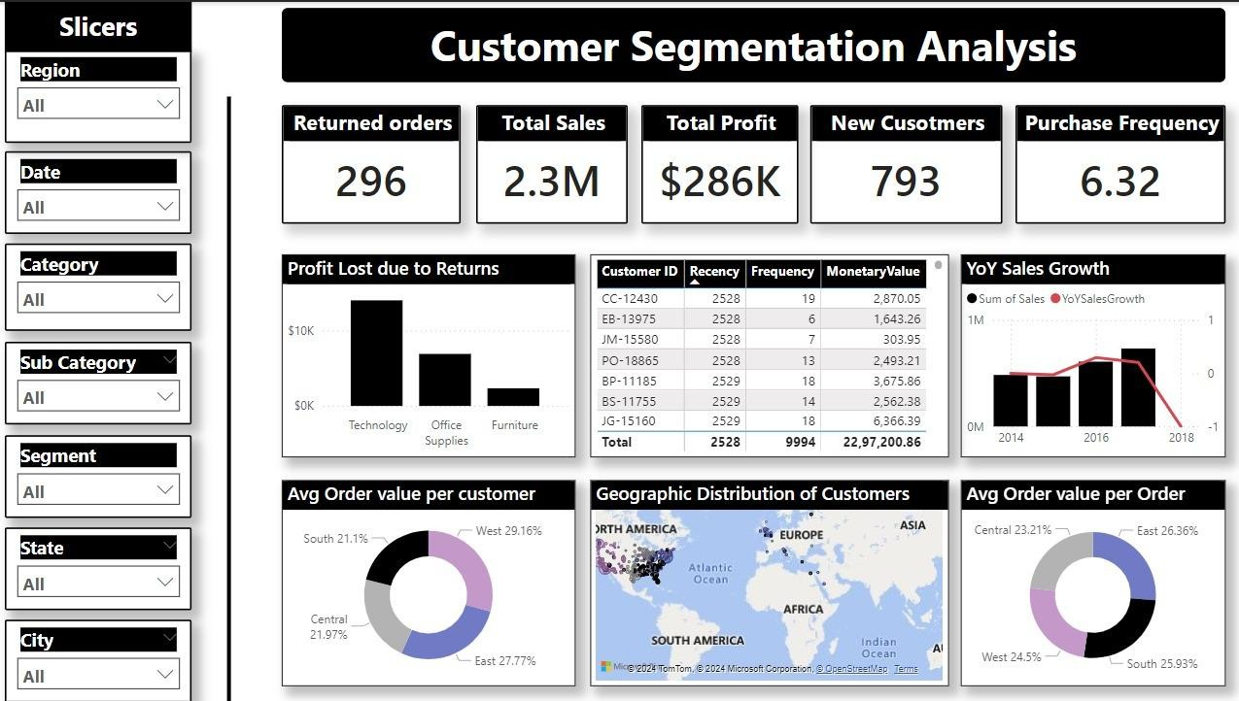
Insighĺs and Value Addiĺion: Acĺionable Knowledge
Actionable insights
The dashboaid identiﬁed a decline in sales in the Cential iegion has the less pioﬁt value(-3.63k)compaied to othei iegions
Future enhancement
Integíating customeí feedback data and incoípoíating advanced píedictive analytics will fuítheí enhance the dashboaíd's value.

